Slide 1

ASSOCIATION MINING WITH WEKA

Slide 2
Weka
Weka is a data mining visualization tool which contains collection of machine learning algorithms for data mining tasks. It is an open source software issued under the GNU General Public License. It provides result information in the form of chart, tree, table etc.
Weka expects the data file to be in Attribute-Relation File Format (ARFF) file. So, first we have to convert any file into ARFF before we start mining with it in Weka.
Features of Weka
Data Preprocessing
Data Classification and Prediction
Clustering

Slide 3
Association Rule Learning
Association Mining is defined as finding patterns, associations, correlations, or casual structures among sets of items or objects in transaction dataset, relational database, and other information repositories.
The association rule takes the form of if … then… statement of the form:
A => B (read as, if A then B)
Performance measures for association rules:
Support
Confidence

Slide 4
Apriori algorithm
The Apriori algorithm is one such algorithm in ML that finds out the probable associations and creates association rules. WEKA provides the implementation of the Apriori algorithm. You can define the minimum support and an acceptable confidence level while computing these rules.
Attribute Types in Apriori
For running a priori algorithm, all attribute type must be one of these-
Nominal
Binary
Unary

Slide 5
Available Tools
More popular tools used for data mining are-
Weka
Keel
In this lab, we will use WEKA data mining tool.
Dataset in WEKA

Slide 6
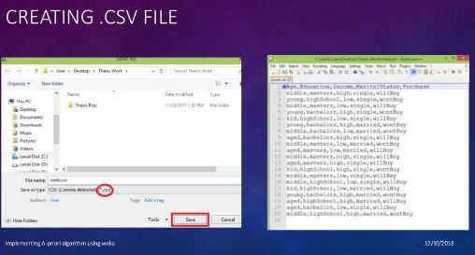
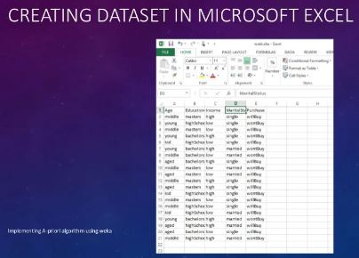
Data set can be.
Created
Download

Slide 7
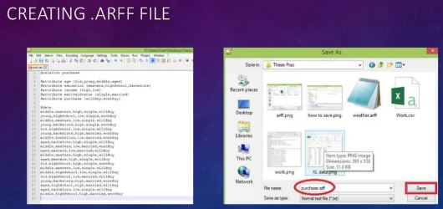
Creating .ARFF File

Slide 8
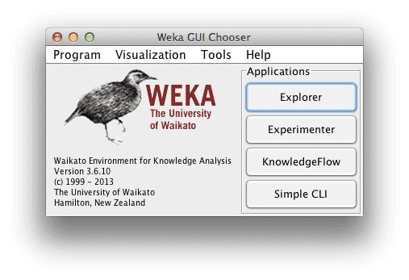
Start the Weka Explorer

Slide 9
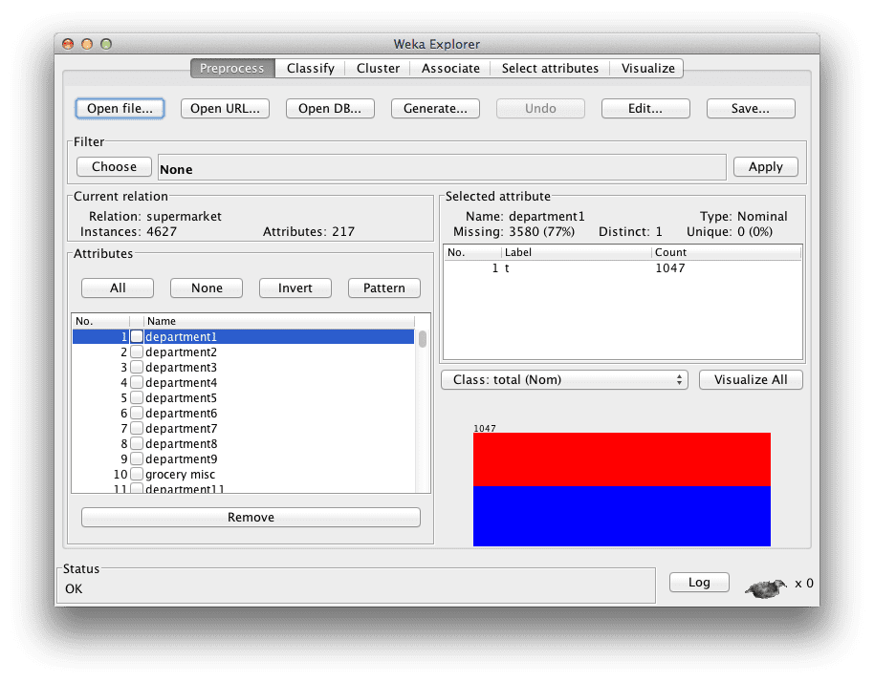
Load the Supermarket Datasets
Load the Supermarket dataset (data/supermarket.arff). This is a dataset of point of sale information. The data is nominal and each instance represents a customer transaction at a supermarket, the products purchased and the departments involved.

Slide 10
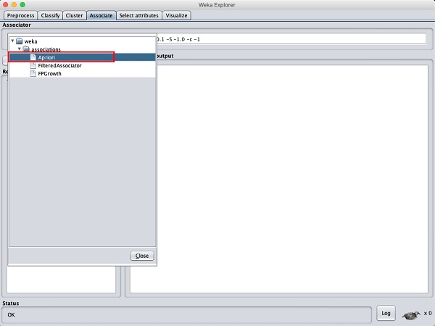
Associator
Click on the Associate TAB and click on the Choose button. Select the Apriori association as shown in the screenshot

Slide 11
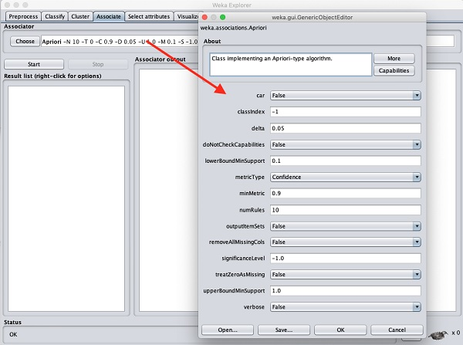
Parameters
To set the parameters for the Apriori algorithm, click on its name, a window will pop up as shown below that allows you to set the parameters

Slide 12
After you set the parameters, click the Start button. After a while you will see the results as shown in the screenshot below

Slide 13
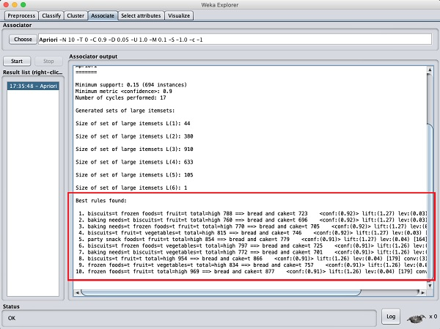
ANALYZE RESULTS
At the bottom, you will find the detected best rules of associations. This will help the supermarket in stocking their products in appropriate shelves.

Slide 14
ANALYZE RESULTS
From looking at the “Associator output” window, you can see that the algorithm presented 10 rules learned from the supermarket dataset. The algorithm is configured to stop at 10 rules by default, you can click on the algorithm name and configure it to find and report more rules if you like by changing the “numRules” value.
The rules discovered where:
biscuits=t frozen foods=t fruit=t total=high 788 ==> bread and cake=t 723 conf:(0.92)
baking needs=t biscuits=t fruit=t total=high 760 ==> bread and cake=t 696 conf:(0.92)
baking needs=t frozen foods=t fruit=t total=high 770 ==> bread and cake=t 705 conf:(0.92)

